Slide 1
Electric Flux Law (Gauss’s Law)
Subhan Ghafoor

Slide 2
Introduction
- Electric flux measures the number of electric field lines passing through a surface.
- Gauss’s Law is one of Maxwell’s equations.
- It connects the electric field with electric charge.

Slide 3
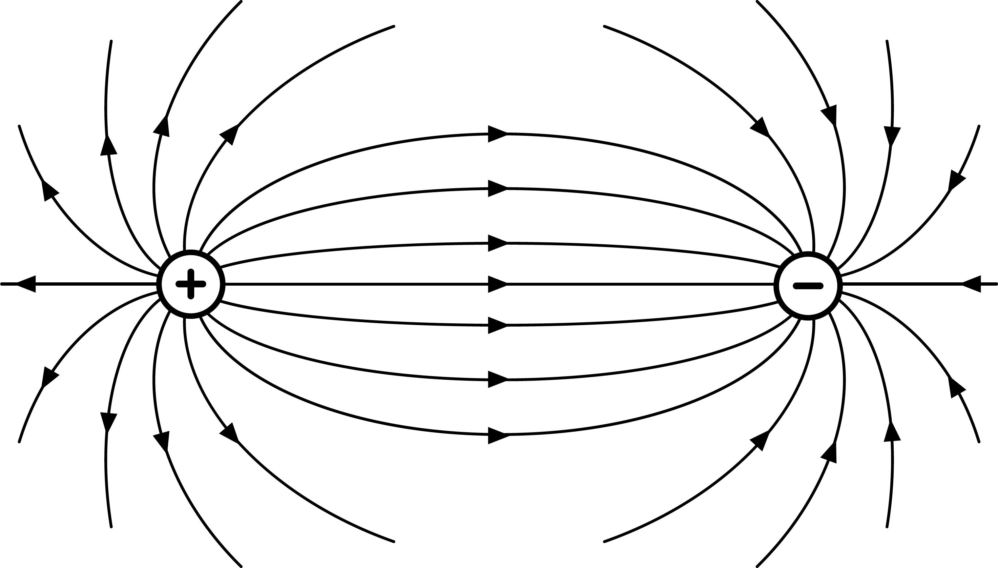
Concept of Electric Field
- Electric field (E) represents force per unit charge.
- Field lines show direction of electric force.
- Positive to negative convention.

Slide 4
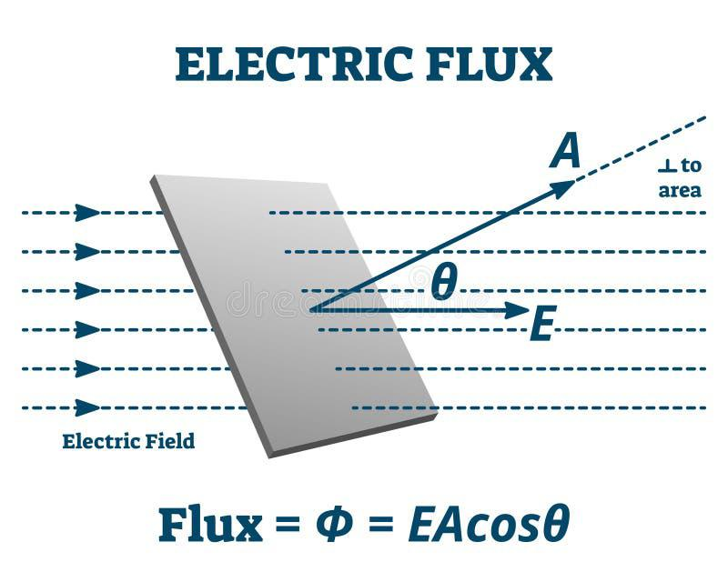
Electric Flux
- Symbol: ΦE
- Definition: Total electric field passing through a given surface.
- Formula: ΦE = E · A = EA cosθ
- Units: N·m²/C

Slide 5
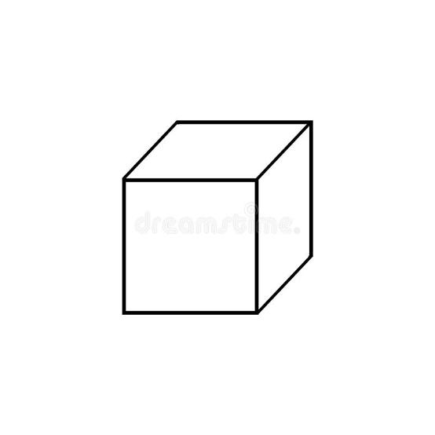

Closed Surfaces
- Gauss’s law applies to closed surfaces (Gaussian surfaces).
- Examples: sphere, cylinder, cube around charges.
- Shape does not affect total flux.

Slide 6
Statement of Gauss’s Law
- Gauss’s Law states:
The total electric flux through a closed surface is equal to the charge enclosed divided by permittivity of free space.
ΦE = ∮ E · dA = Q_enclosed / ε0

Slide 7
Physical Meaning
- Electric flux depends only on the charge enclosed.
- Field lines start from positive charges and end at negative charges.
- Outside charges do not contribute to net flux.

Slide 8
Conclusion
Electric flux law is a fundamental electrostatics law.
Links electric fields with charges.
One of Maxwell’s four equations.
Foundation of electromagnetism.

